Slide 1




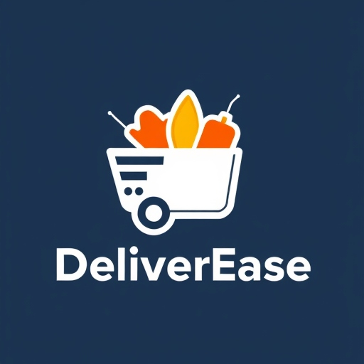
DeliverEase Every Meal, One App Away! Presented by : Pratik Nesarkar | Ms - MIS Texas A&M University
Product Canvas
Notes:
Howdy! I am Pratik Nesarkar a graduate student at the Mays Business School and today I am going to present to you my product canvas that I created for the DeliverEase Application for your Smartphone. As the tagline says, ‘Every Meal – just one app away.’ I’ll walk you through the key aspects of this innovative product, including its vision, metrics for success, core features, user personas and lastly some catchy visuals in terms of a storyboard demonstrating the user experience. Let’s dive in!

Slide 2


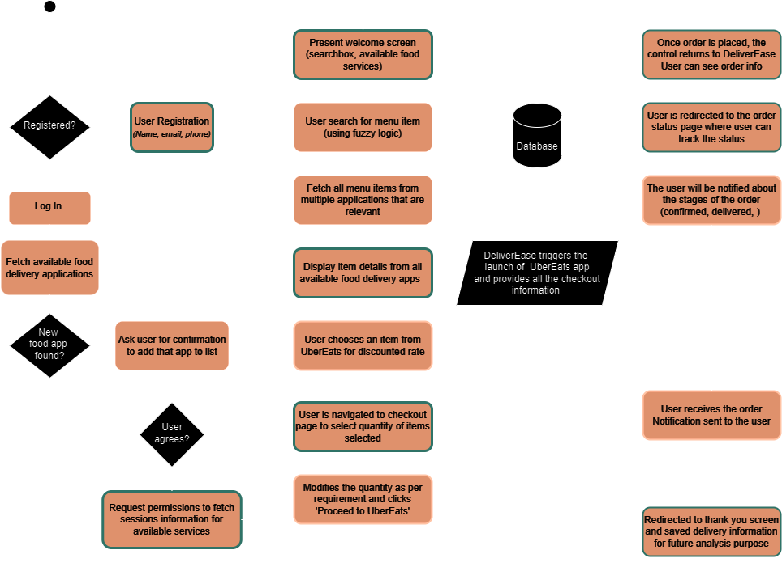



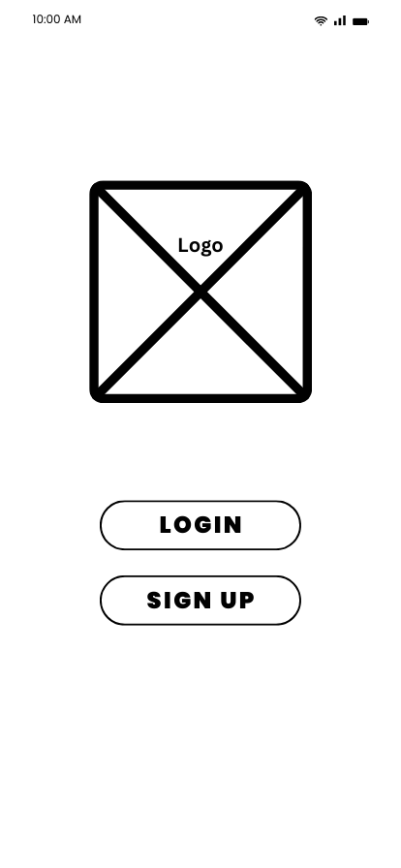

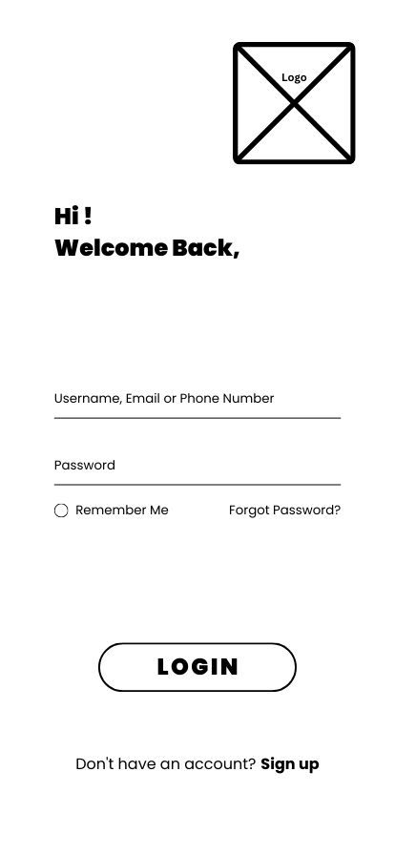
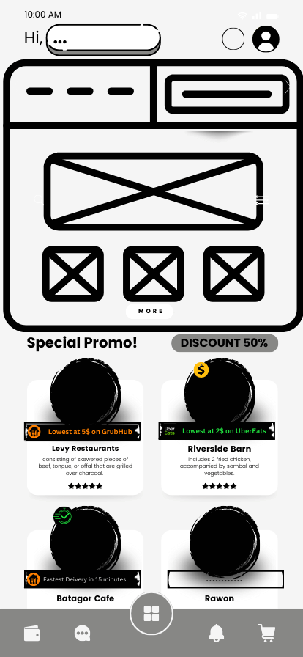
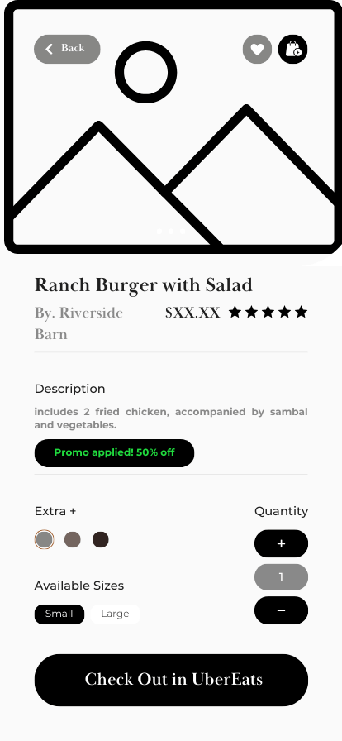
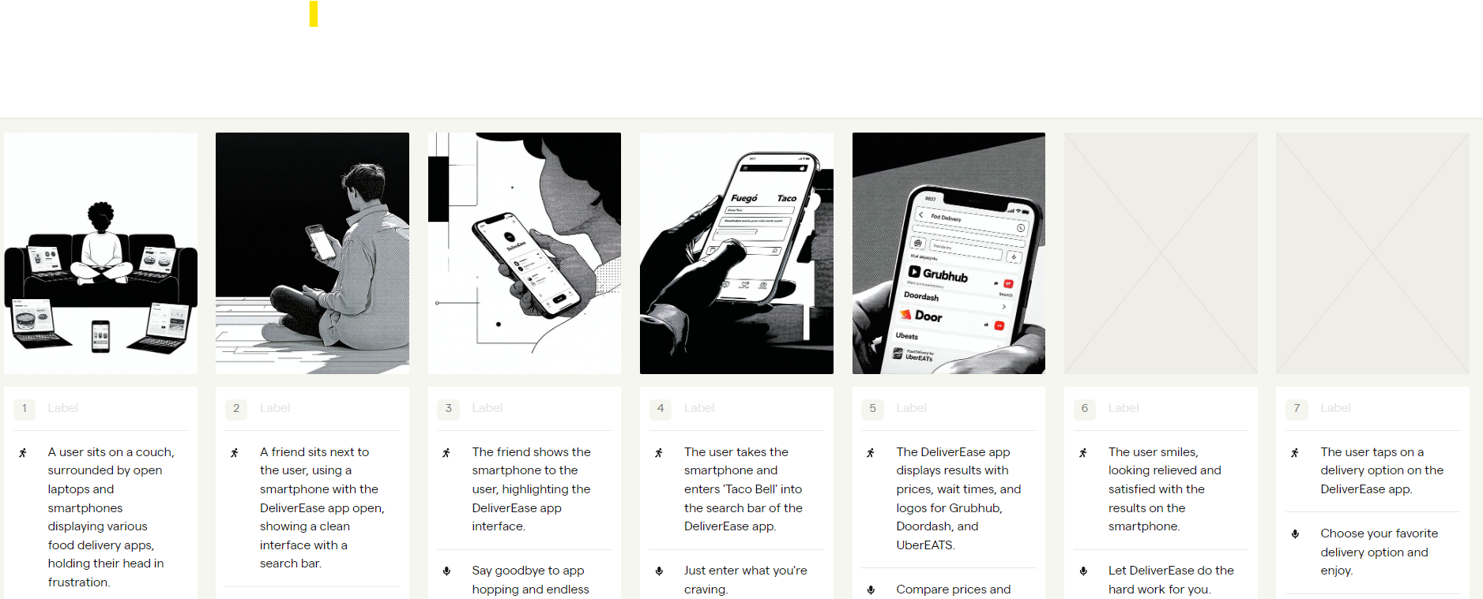
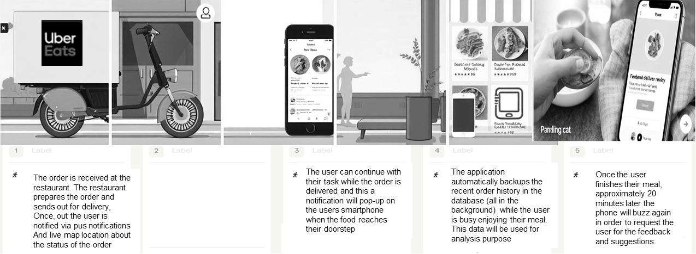



DeliverEase
Achieve a 30% reduction in user decision-making time by optimizing food delivery search, comparison, and checkout flows within the next six months, empowering users to select the best food delivery options faster and with fewer steps.
User Personas
Target users from varied age group, locality, and financial backgrounds along with their needs from the new application
Epic
Workflow
Effortless Food Delivery Comparison and Ordering with DeliverEase. A streamlined platform for comparing food delivery options.
AGE:
35
LOCALITY:
Urban City
ROLE:
Night Shift Security Guard
INCOME:
$35,000 per year
NEEDS:
Quick & convenient food options
Order food during night when most places are closed
Create the registration page
Unified Fuzzy Search
Real-time comparison options of prices, delivery times & discounts.
Track delivery status .
Highlight key daily discounts
Seamless integration with external food service apps
Ad-Free support with subscription for more quicker and streamlined experience.
AGE:
29
LOCALITY:
Suburban Town
ROLE:
Nutritionist
INCOME:
$50,000 per year
NEEDS:
Follows a strict diet plan (vegan)
App shows detailed food insights
An app that is within budget
56 & 48
Metropolitan City
AGE:
LOCALITY:
ROLE:
Busy Parents (Factory workers)
INCOME:
$40,000 per year
NEEDS:
Family-sized healthy meals options
Affordable, bundled meals
Scheduling for weekly meal delivery
Big Picture
Core User Experience
Unified Search
Side-by-Side Comparison
Seamless Ordering Process
Real-Time Order Tracking
Personalized Experience
Deals and Discounts Integration
Success Metrics
Wireframes
Users Activity: Reach 2000 daily active users
User retention rate > 55%
Monthly 20% new users added
Conversion rate: Convert 10% of users quarterly from free to paid
Monetize anonymized user data
Reduce food search and order time by 30% annually
Implement location based alerts for best meal items from around 5 miles radius
A single-point food delivery comparison application designed to make life easier by giving the big picture in one place.
Main Features
Multi-Platform Search and Compare
Dietary Filters and Customizations
Order History and Quick Reorder
Family-Friendly Options
Storyboard
?
?
6
7
8
9

Slide 3
DeliverEase
Every Meal,
One App Away!
Vision: DeliverEase aims to be a quick, hassle free, and trusted one-stop solution for consumers to compare real-time food delivery service pricing, wait times and personalized promotions offered by multiple food delivery services such as GrubHub, UberEATS, etc. on the go. With a vision to capture more than 90% of the market share by the end of 2025.
Following are the goals that we aim to achieve:
Save valuable user time
Minimize the hassle of navigating through multiple apps
Quickly order their daily/weekly meal plans with minimal system interaction
User friendly user interface
Best in class privacy and security features

Slide 4
Big Picture
Overview: DeliverEase is a single-point food delivery comparison application designed to make life easier by giving the big picture in one place. Aggregating from major delivery platforms like Grubhub, DoorDash, and UberEATS, it helps a user make quicker, more affordable decisions without having to toggle between applications. DeliverEase focuses on speed, cost savings, and ease of ordering-features that best match what a user needs.
Core User Experience
Unified Search: Users can search for specific restaurants, cuisines, or items, and DeliverEase retrieves options from all linked platforms. The app uses fuzzy search to simplify finding items without needing exact names, allowing users to type in broad terms like "veggie pizza" or "taco".
Side-by-Side Comparison: DeliverEase’s key feature is its comparison tool, where users view side-by-side delivery times, fees, and any promotions across platforms. This is essential for saving both time and money, especially for users looking for the best deal or the fastest delivery.

Slide 5
Big Picture (Contd…)
Seamless Ordering Process: Users add items to their DeliverEase cart and then select the desired delivery service at checkout. DeliverEase transfers the order to the chosen platform, populating the items automatically in the external app, eliminating the need to re-enter information.
Real-Time Order Tracking: After ordering, users receive real-time updates on their delivery status, from confirmation to arrival, including estimated delivery times and live tracking on a map.
Personalized Experience: The app’s algorithm tailors recommendations based on users’ past orders, favorite restaurants, and dietary preferences, providing a personalized experience that adapts over time.
Deals and Discounts Integration: DeliverEase aggregates all available promo codes and discounts across platforms, automatically applying any that match the user’s selected items or preferences. For example, users are notified of a “buy one, get one free” deal if it’s available for their chosen restaurant.

Slide 6
Big Picture (Contd…)
Main Features
Multi-Platform Search and Compare: Simplifies searching across multiple delivery apps, giving users a single, consistent interface to compare options.
Dietary Filters and Customizations: Allows users to filter options by dietary preferences (e.g., vegan, gluten-free) or other customizations to find meals that meet specific needs.
Order History and Quick Reorder: Saves favorite items and past orders for fast reordering, catering to users who frequently reorder the same items.
Family-Friendly Options and Bundles: Supports family-sized orders and bundled deals for busy parents or group orders, with features to split bills or manage multi-item carts.
User Profiles and Preferences: Each user can create a profile that stores preferred payment options, saved addresses, dietary restrictions, and order history for a personalized experience.

Slide 7
Product Success Metrics
Users activity (weekly or monthly)
Reach 2000 daily active users to collaborate with companies for advertisements
User retention rate greater than 55% along with a monthly 20% new users added monthly
Conversion rate (free to paid)
Convert 10% of users quarterly from free ad-based version to paid add-free version to generate recurring revenue
Monetize anonymized user data by collaborating with agencies that want it for research and analysis
Generate quality metrics for analysis
Application maintains record of past orders and generates weekly, monthly, quarterly report
Generate a eagle eye view of the application performance showing sales data from 3 major food providers for administration purpose
Smart recommendation system
By recording users order history, location and time app suggests for possible meal choices with best deals through in-app notifications to the users
Location based alerts for best meal items from around 5 miles radius
Notes:
Ability for a user to create an account and login
Ability for a user to search, compare, and add food items to cart from DeliverEase app (without need of navigating to other app)
Reach 2000 daily active users to collaborate with advertising companies
Admin receives daily app usage statistic reports
App allows for searching with fuzzy logic (restaurant, item, type, veg/non-veg, vegan, etc…)
The app maintains a record of past orders to help user re-order in one click
The app provides order history and information about sales (who, when, where, etc…)
The app also intelligently suggests meals based on location, time, and past orders.

Slide 8
Target Groups
Health-Conscious Foodies: They focus on keeping a balanced diet and will more often than not seek out meal choices that will fit certain dietary needs: keto, vegan, or low-carb. They prefer platforms that can filter options by calorie count, ingredients, or dietary restrictions.
Remote Workers in Rural Areas: Those who work from home in less-populated areas will have fewer delivery options and then depend on services that cover more ground. They appreciate the transparency of the delivery times and the restaurants available that can cover the longer distances for delivery.
Freelancers & Digital Nomads: They are moving quite often between cities and countries, so they will be interested in the same set of reliable food options in each place. They would love apps that could adapt to different regions, offering local food insights and reviews by other travelers.
Busy parents of young children: Parents who often look for quick, affordable, family-friendly dining options appreciate features such as bundled meals or child-friendly options. They benefit from delivery applications that offer them precise delivery time, discounts, and flexible ordering with a busy schedule in mind.
Night Owls and Shift Workers: They include staff from the nearby hospitals, security guards, among others who work odd hours and need access to food delivery services in the dead of night. They would look for platforms with a wide range of 24/7 delivery options and reliable customer support during odd hours.
Eco-Friendly People: These users emphasize sustainable choices and seek restaurants that serve food with either eco-friendly packaging or locally sourced ingredients. They appreciate transparency in their order's carbon footprint or the availability of green options.

Slide 9
User Personas
Aron
TaAra
Chris & Taylor
Age: 35’
Low earnings, long shifts,
Odd meal timings
Night shift security guard
Age: 56’ and 48’
2 children, both busy working professionals,
Usually order family-size meals Factory workers
Age: 29’
Vegan, health conscious, gymnast Nutritionist at a wellness clinic
Notes:
Aron: Age: 35’ Tech-savvy, night shift worker, long hours
Taara: Age: 29’ Vegan, health conscious, gymnast Nutritionist
Rahul & Devi: Age: 24’ Both are in a factory, Work long hours, mostly order online in a xl quantity
Ram: Age 40’ Single, cooks poorly, day job with no fixed location, Carpenter

Slide 10

Aron J.
ABOUT
Aron, a 35-year-old security guard working in a 24/7 corporate office complex. He has been living away from his home ever since his early 20’s. With his busy schedule and frequent long hours, he relies on food delivery services to save time on meal prep and enjoy the convenience of having food brought directly to his door. Aron orders food delivery several times a week and values efficiency, reliability, and an intuitive ordering process. He’s tech-savvy but doesn’t want to spend extra time navigating between multiple apps to compare prices and delivery times. He appreciates a streamlined experience that lets him quickly find what he wants, select the best option, and get back to his day without disruptions.
Aron is usually tied to his desk major time of the day and only takes occasional breaks. These breaks are very short and he only gets a small window where he can use his cell-phone prior to the breaks. This is why Aron is frustrated about having to use 4-5 different food delivery apps every time he wants to have a meal.
AGE:
35
ROLE:
Night-shift Security Guard
NEEDS
A quick way to compare delivery times and prices across services
An intuitive, no-fuss app that remembers her preferences for faster reordering
Reliable information about the delivery times at late night
The app should be secure and not store sensitive information from his wallet
Access to high-energy meals through the night
Does not have any issue with advertisements in the application
LOCALITY:
Urban City
Works late night daily, introvert, enjoys eating alone
KEY METRICS
Socioeconomic Position
PAIN POINTS
Limited diet options during night time
Often short lunch-break and can’t waste time navigating between apps
No single means to search for food items across multiple food delivery applications on the go
Current applications have cluttered UI and unwanted pop-ups that waste time
Difficult to order in 2-3 clicks, no re-order last meal option available in all apps
Technical Literacy
Schedule constraints
Scale of expense

Slide 11
Taara S.
ABOUT
Taara is 29, currently a nutritionist a Texas A&M Health Sciences Department. She is actively juggling work, lab sessions , and a full-time job. Living off-campus with a few roommates, she often turns to food delivery for quick meals between her packed schedule. When she’s not studying or hanging out with friends, Taara enjoys exploring local food options and trying new places. She prefers eating only diet conscious food though! For her, food delivery is about convenience, cost-saving and flexibility, fitting seamlessly into his busy college life. The cost aspect is one of the most important as she also tends to save smartly.
She follows a strict pescatarian diet and often searches for meals that align with her values of sustainability and health. None the less, she is passionate about trying variety of food items and wants to explore varied variety of food daily. She is also vegan that makes it frustrating for her to set the preference every time in the food delivery apps she uses daily.
AGE:
29
ROLE:
Nutritionist at Wellness clinic
NEEDS
Easy filtering of menu items based on dietary preferences set once initially
A free version of the app with ads, but also open to pay a small fee for an ad-free version if affordable
Push notifications on the phone when discounts are available
An eco-friendly restaurant that uses sustainable packaging
She absolutely needs a intuitive and clean UI to compare quickly on the go
LOCALITY:
Suburban City
Health Conscious, foodie, eco-friendly
KEY METRICS
Socioeconomic Position
PAIN POINTS
Limited healthy options available on most apps, too many fast food options
Different platforms have different promo code options and cannot check one by one for every platform
Lack of transparency: have hidden fees towards the end stage of ordering
Premium plans of delivery are on the higher end
Frequent packaging waste, which goes against her eco-conscious values
Technical Literacy
Schedule constraints
Scale of expense

Slide 12
Chris & Taylor
ABOUT
Chris (36) and Taylor (34) are a married couple with two young kids, ages 4 and 7. Both work full-time – Chris in IT and Taylor as a teacher – which leaves them with little time for meal preparation. They seek food delivery solutions that cater to family needs, balancing quick delivery with a variety of affordable, kid-friendly meal options. They appreciate meals that the entire family will enjoy compromising on health.
The kids are foodie and eat a lot, while Chris is a cyclist and so he eats a full healthy meal. Taylor has longer shifts on weekdays and so she cannot cook daily. They cook together on the weekends, but for all the other days of the week, with kids going to school, the timelines are very packed and they needs a reliable service that can accept weekly food plans and deliver them on time everyday.
They need healthy options to ensure that the kids stay in the best health.
AGE:
58 & 48
ROLE:
Factory workers
NEEDS
Family-sized meals that offer a balance of nutrition and kid-friendly options.
Affordable, bundled meals to feed the whole family without overspending.
Quick delivery, especially on weekdays when both are busy with work and after-school activities.
Options to order food in advance or schedule weekly deliveries
LOCALITY:
Metropolitan City
Foodie, gym enthusiast, two young kids, cyclist
KEY METRICS
Socioeconomic Position
PAIN POINTS
Many apps lack bundled family deals, making individual orders more expensive.
Limited healthy and kid-friendly options, with too many spicy or complex dishes.
Challenges finding variety without paying high delivery fees.
Often faces inaccurate delivery times, which disrupts their evening routines.
Technical Literacy
Schedule constraints
Scale of expense

Slide 13
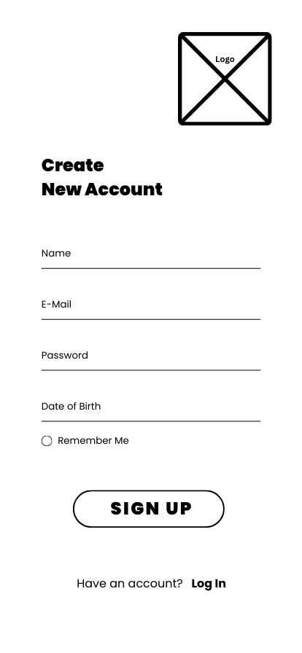
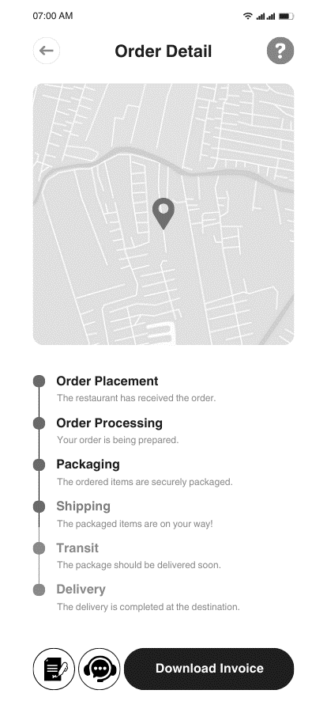
Wireframes
The initial landing page for the app, where it allows existing users to navigate to login page and new users to the registration page
The login page verifies if the user exists in the system and then allows them to enter the application
1
3
The Registration page allows new users register and verifies their information. Once verified they are taken to the login page
2
The menu selection page allows user to add one or more menu item to the bag and checkout the order from users own application
by switching from the current
5
The home screen allows users to search for a food item and then displays cheapest/fastest options for them to checkout
Once ordered, the application then allows user to track their order with real time updates till the order is delivered to the user
4
6
Notes:
Frame 1: Landing Screen
Frame 2: Registration Page
Frame 3: Login Page
Frame 4: Home Page
Frame 5: Checkout to External App Page
Frame 6: Order Tracking Page

Slide 14
Workflow
Notes:
Open app > Register > Login > Fetch all delivery apps > Present welcome screen > Fetch menu items based on search > show all the prices and discounts based on user profile > Navigate to checkout > Launch selected application > Place order > Return to DeliverEase > Track order status > Redirect to thank you screen and feedback

Slide 15

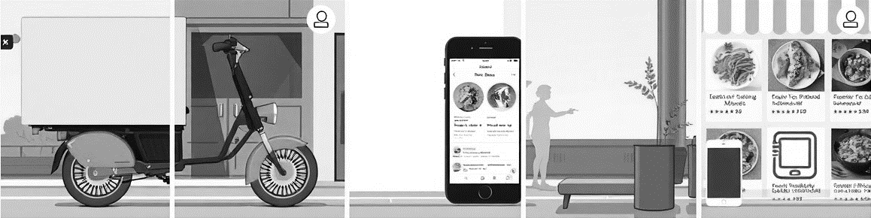
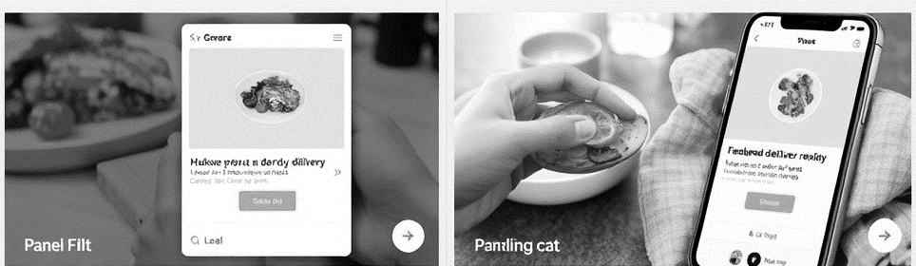

Storyboard
6
7
8
9
The order is received at the restaurant. The restaurant prepares the order and sends out for delivery,
Once, out the user is notified via pus notifications
And live map location about the status of the order
The user can continue with their task while the order is delivered and this a notification will pop-up on the users smartphone when the food reaches their doorstep
The application automatically backups the recent order history in the database (all in the background) while the user is busy enjoying their meal.
This data will be used for analysis purpose
Once the user finishes their meal, approximately 20 minutes later the phone will buzz again in order to request the user for the feedback and suggestions.

Slide 16
Epic
This epic focuses on providing users with a seamless experience to search for and compare food delivery options from multiple platforms (e.g., Grubhub, DoorDash, UberEATS). By aggregating and displaying critical information such as price, delivery time, fees, and potential discounts, DeliverEase empowers users to make quick, informed decisions without switching between multiple food delivery applications.
Feature 1 : Design and create the Registration page to get new users onboard and verify them via email / SMS verification.
Feature 2 : Unified Fuzzy search across multiple platforms, restaurants, food items and cuisines. Cluster all the results into a single result set from UberEATS, Doordash, etc.
Feature 3 : Real-time and user friendly comparison options of prices, delivery times and possible discounts. Sorting functionality based on user preference like price, rating, etc.
Feature 4 : Track status of orders from confirmation to delivery. Implement the push notification capabilities in the application for updates and timely alerts.
Feature 5 : Highlight key discounts that different platforms offer and automatically apply them if they are applicable.
Feature 6 : Seamless integration with external apps so that DeliverEase wont be syncing any sensitive card information or any other payment related data.
Feature 7 : Ad-Free support with subscription for more quicker and streamlined experience. In-app support to report any issues of need to contact customer support.
Feature 8 : Multi device synchronization for even more flexible user experience.
Notes:
epic

Slide 17
Feature ID | User Story | Acceptance Criteria | Priority
1 | 1.1 As a user, I want to search for specific food items or restaurants, so that I can find what I’m craving without browsing multiple apps. | A search bar allows users to input a restaurant name, cuisine type, or food item. Results display relevant options across multiple delivery platforms (Grubhub, DoorDash, UberEATS) with prices, estimated delivery times, and ratings. Filters for refining search by cuisine, price, ratings, and delivery time. | High
1 | 1.2 As a user, I want to search using dietary needs like gluten-free or vegan options, so that I only see results that meet my requirements. | Filter options for dietary preferences such as vegan, gluten-free, low-calorie, etc. Results are updated dynamically based on dietary filters selected by the user. | Medium
2 | 2.1 As a user, I want to compare estimated delivery times, so that I can choose the fastest service for my order. | Display of estimated delivery times from each platform. Option to prioritize results based on the shortest delivery time. | High
2 | 2.1 As a user, I want to compare prices and delivery fees across platforms, so that I can choose the most affordable option. | Comparison table displaying prices, delivery fees, estimated times, and discounts from each delivery platform. Option to sort results based on price, delivery time, or ratings. | High
Notes:
User story

Slide 18
Feature ID | User Story | Acceptance Criteria | Priority
3 | 3.1 As a user, I want an estimated time of delivery and live map tracking, so that I can see exactly where my order is at any moment. | Display estimated delivery time on the app’s interface. Real-time map view showing delivery driver’s location. | Medium
3 | 3.2 As a user, I want to track my order status and receive notifications, so that I’m updated throughout the delivery process. | Order tracking feature with live updates on the order status (e.g., preparing, enroute, delivered). Push notifications for significant status updates (confirmation, preparation, dispatch, and delivery). | High
4 | 4.1 As a user, I want to see available discounts and apply promo codes, so that I can maximize savings on my orders. | Display of applicable promo codes and discounts from each delivery platform for selected items. Seamless integration of promo codes at checkout. | High
4 | 4.2 As a user, I want to know if I qualify for a first-time user discount on any of the platforms, so that I can try out a service at a lower cost. | Display of available new user discounts specific to each platform when applicable. Option to apply new user discounts automatically if eligible. | Medium
5 | 5.1 As a user, I want to save my favorite restaurants and view my past orders, so that I can reorder with ease. | Option to mark restaurants or items as favorites for quick access. History of past orders with details (items, delivery service used, price). “Reorder” button for easy repeat orders. | High
Notes:
User story

Slide 19
Feature ID | User Story | Acceptance Criteria | Priority
5 | 5.2 As a user, I want to review my most frequent orders and spending, so that I can make more informed food choices. | Section showing frequently ordered items and total spending from past orders. Insights on order frequency and spending pattern by restaurant or cuisine. | Medium
6 | 6.1 As a user, I want an easy checkout experience with integrated payment options, so that I can complete my order without hassle. | Integrated checkout process that connects with the chosen delivery service for payment and confirmation. Support for multiple payment methods (credit card, debit card, digital wallets). | High
6 | 6.2 As a user, I want a single-click checkout option if I reorder from the same place, so that I can save time | Option to reorder with a single click for previous orders with the same item selections. “Quick Checkout” button for saved favorite items and past orders. | Medium
7 | 7.1 As a user, I want family meal deals or bundled options, so that I can order for my family at an affordable price. | Family meal deals and bundled options visible for applicable restaurants. Split billing option if ordering with a group. | High
8 | 8.1 As a user, I want a loyalty rewards section that shows points and discounts I can earn, so that I feel incentivized to use the app regularly. | Dedicated section showing loyalty points or rewards accumulated from orders. Option to redeem points for discounts or special offers in-app. | Medium
Notes:
User story

Slide 20
Thank you!

